Slide 1
Youtube Trending Analysis
Final
Report
Tsing Anson AU-YEUNG
Chen LIN
Ting Yuan LIN
Zengyu LIU
Zhengyu LIU

Slide 2
Contents
01.
Introduction about the Project
02.
Webpage Analysis and Data Scraping
Exploratory Data Analysis
Predicting Likes
03.
04.
Summary
05.

Slide 3
Introduction
Part 1

Slide 4

1.1 Motivation
Our project is about Youtube Trending Videos Analysis, using data collected by Youtube API. Exploratory data analysis and Regression method will be conducted to better understand the video patterns and get some insights, which may be helpful for those who want to gain popularity of their videos on Youtube.
1.2 Goals
Analyse what factors affect how popular a YouTube video will be using EDA. The information we will try to find is like:
How many views do our trending videos have? Do most of them have a large number of views? Is having a large number of views required for a video to become trending?
What are the most common words in trending video titles?
…
Predicting likes using Regression model
1.3 Dataset
This dataset focus solely on US region, including several months (and counting) of data on daily trending YouTube videos. We collect the data using API and combine these data with the data from kaggle, since there are only 200 pieces of data we can collect using API and we do not have enough time to get a large number of data solely depending on Youtube API.
Variables include the video title, channel title, category_id, publish time, tags, views, likes and dislikes, description, and comment count etc.

Slide 5
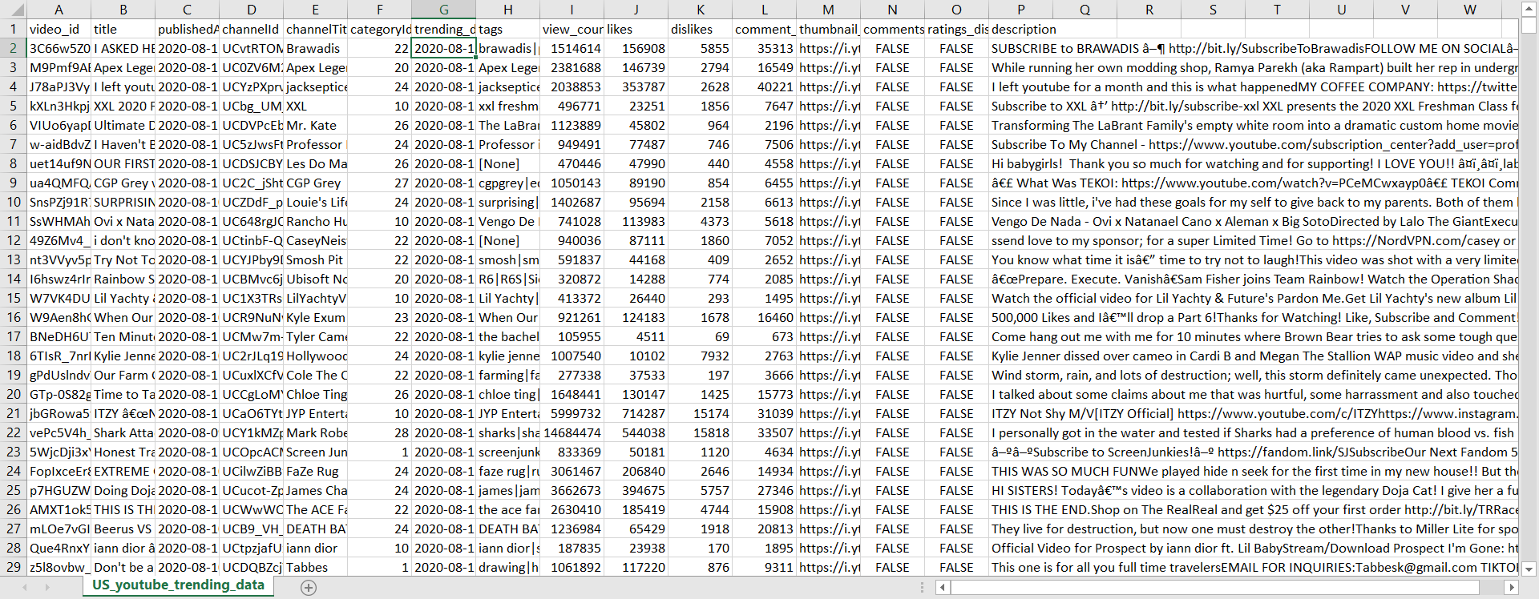
Dataset

Slide 6
Webpage Analysis and Data Scraping
Part 2

Slide 7

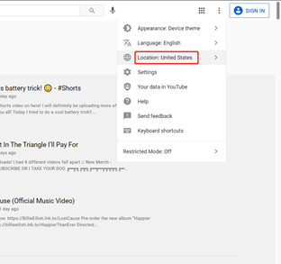
Webpage Analysis
Shortcoming 1
the webpage only shows the top 50 trending videos. In data analytics field, 50 record of data provide very limited information.
Shortcoming 2
since our goal was to merge extracted data with our original dataset from Kaggle, we found that several features is not directly included in the webpage.
In summary
we believe the data from 50 trending videos are not enough for future analysis. Also, the approach is quite cumbersome in terms of gathering necessary features when implementing. Therefore, we decided to look for the API that supports trending video scraping on YouTube.

Slide 8
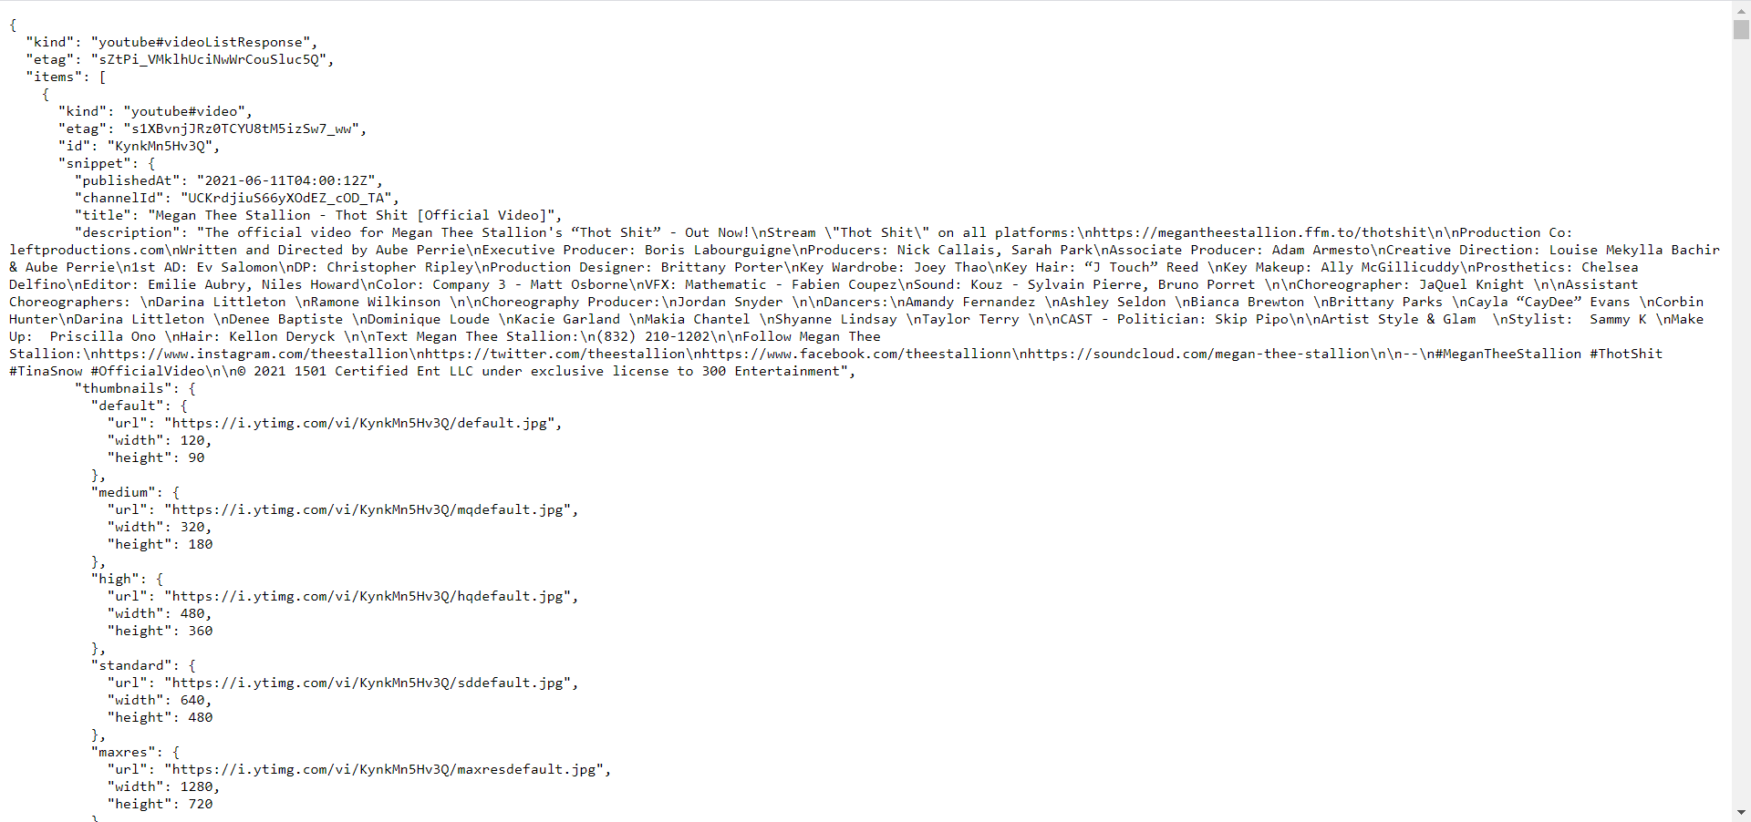
YouTube API

Slide 9
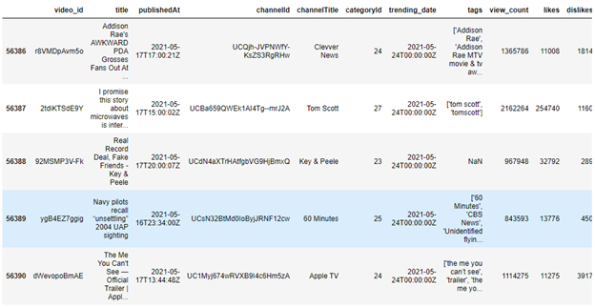
Data via YouTube API and Data Scraping
With this API data gathering approach, we successfully retrieve 200 trending videos per day. It may be true that 200 record of data is considered trivial still, but we believe we could obtain the data of daily trending videos by executing our python code every day. Due to the time limitation in this project, we will only extract data of trending videos on May 24th and combine the 200 data record with original Kaggle dataset. The sample combined dataset is shown below.

Slide 10
Exploratory Data Analysis
Part 3

Slide 11
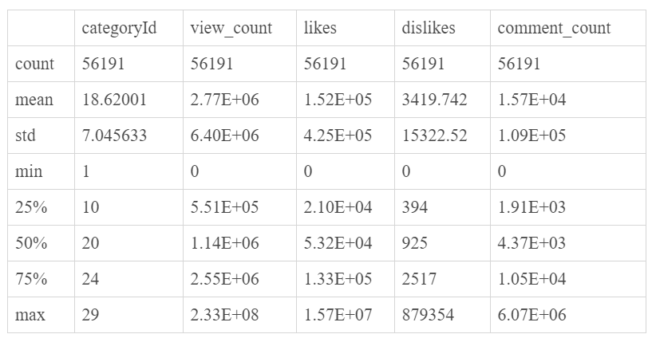
Data preparation
Data cleaning: replace null value in description column with ""
Discription of data
We can see that the data of view_count,likes and dislikes is very dispersed since the std is very large.

Slide 12
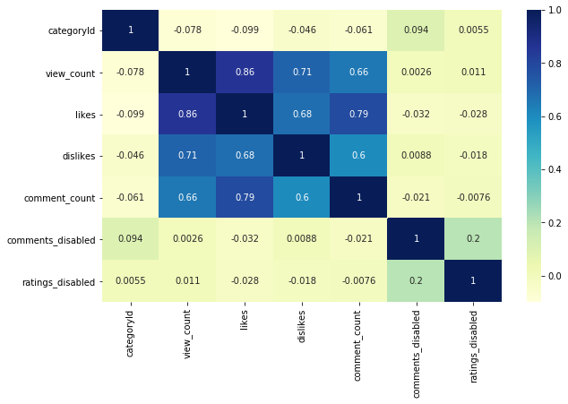
Analysis of numerical and categorical variables
The correlation between numerical variables
We can see that view_count,like, dislikes and comment count have strong positive correlation, the coefficients are all above 0.6. While others simply does not correlate with each other.

Slide 13
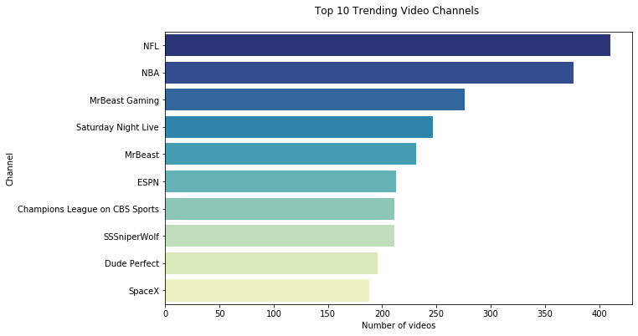
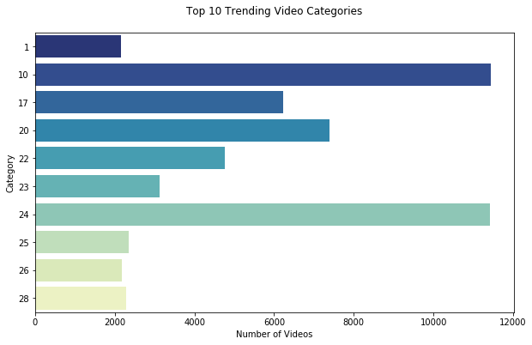
● Video channel and category
NFL rank top1, having 400 trending videos. And second follows NBA.
The top 3 popular video category's ids are 24,10 and 20 which are Entertainment, Music, and Gaming respectively.

Slide 14
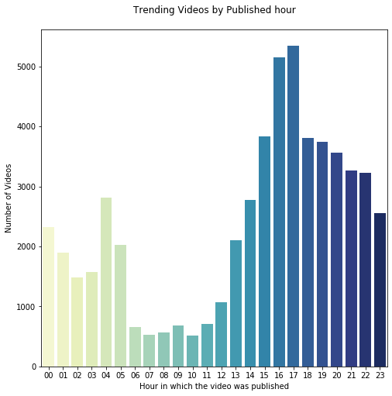
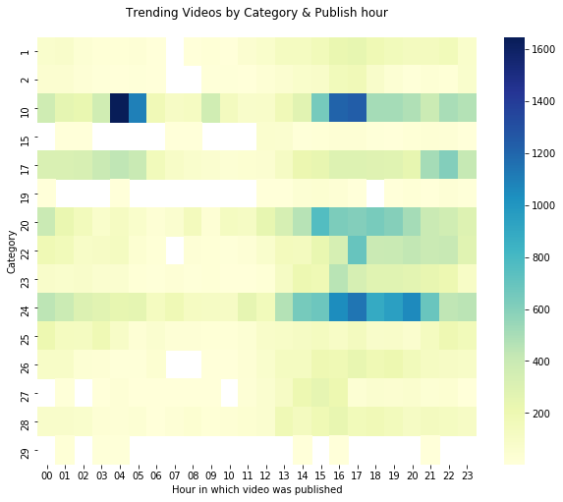
● Pulished time
We can see that most videos were published between 15:00 and 22:00, and in contrast, very little number of videos were published between 6:00 and 11:00.
And combined with the video categoryID, we can see that the most popular video category are highly correlated with the most popular published time.

Slide 15
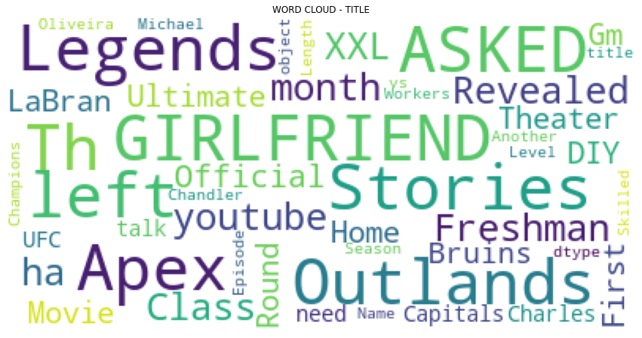
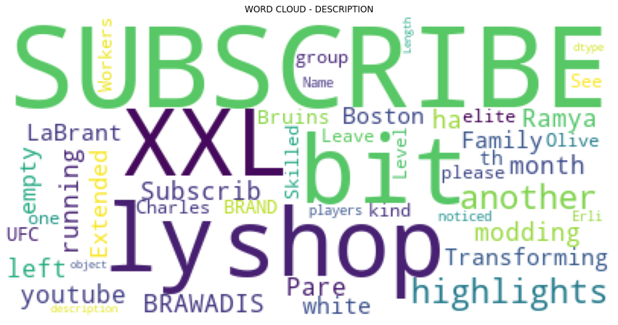
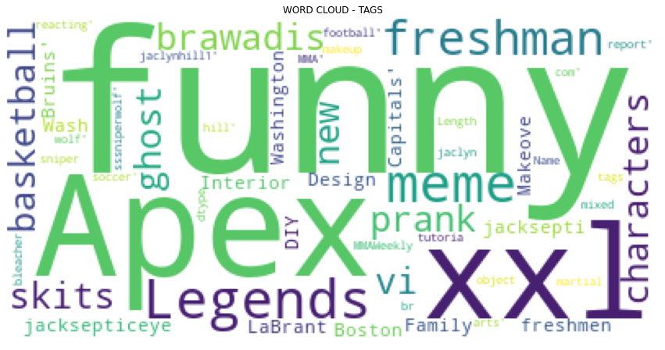
Analysis of text data
We try to highlight the words that highly used by word cloud. For titles, there are several with similar ranks, like 'GIRLFRIEND', 'ASKED', 'Apex' and 'Legends'. This reveals the contents of the trending videos is related to relationships and gaming which somehow echoing with our previous finding. Thus, video creators could always consider making their titles as direct as possible and they could also consider making content related to these themes.
For description, 'Subscribe' are the most frequently used word. This shows that those video creators usually ask their viewers to subscribe which is not surprising. According to Youtube policy, how quickly the video is generating views, as known as 'Temperature' is one of the signals that determines if that video could rank on trending. Once subscribers are notified that the channel they subscribed has updated a new video, they will tend to click and watch the video immediately. Thus this somehow proves that video creators are trying to make use of this factor to get on trending.
For tags, 'funny' ranked highest. This is a completely random word compare with those others in our study, revealing that tags could be unrelated to the content of the video except that it is a keyword that people search most.

Slide 16
Predicting Likes
Part 4

Slide 17
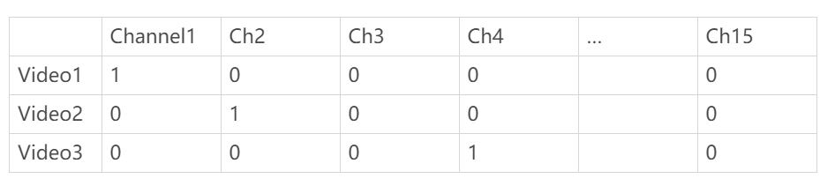
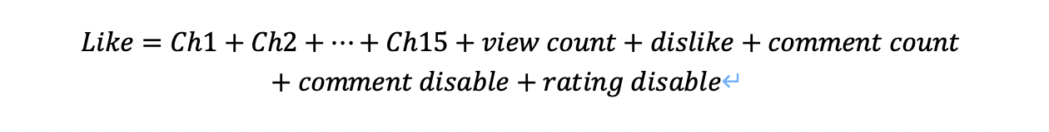
In the previous part of the project, we conclude that there are several variables are highly correlated to the like number. So, we should select them as the control variables to ensure the validity of the model. So, the complete regression model is as below:
Each video will be classified into a channel, and there are 15 channels available in the dataset. Here the project constructs a series of binary variables to demonstrate the channel that the video belongs to.
If the value equals to 1, the video belongs to that channel. For example, video 1 is belongs to channel 1.
The result of the regression model indicates that Ch1, Ch2, Ch15, Ch17, Ch19, Ch25, Ch26, Ch28 play a negative effect on the like number. So, the remaining channels are recommended.

Slide 18
Summary
Part 5

Slide 19
Like number of a YouTube video is affected by countless factors in the real world.
The current dataset requires more variables within the YouTube.
Fan numbers of the uploader
The duration of the video
….
The variables outside YouTube.
Social news
Google search trend
…..

Slide 20
Thanks

